Slide 1
Computational Tools to unmask Transposable Elements
Kundaje Lab Journal Club
Nov 6 2018

Slide 2
Some History: “Jumping Genes” in maize
Barbara McClintock discovered the first TEs in maize (Zea mays) at the Cold Spring Harbor Laboratory in New York. McClintock was experimenting with maize plants that had broken chromosomes.[5]
In the winter of 1944–1945, McClintock planted corn kernels that were self-pollinated, meaning that the silk (style) of the flower received pollen from its own anther.[5] These kernels came from a long line of plants that had been self-pollinated, causing broken arms on the end of their ninth chromosomes.[5] As the maize plants began to grow, McClintock noted unusual color patterns on the leaves.[5] For example, one leaf had two albino patches of almost identical size, located side by side on the leaf.[5] McClintock hypothesized that during cell division certain cells lost genetic material, while others gained what they had lost.[6] However, when comparing the chromosomes of the current generation of plants with the parent generation, she found certain parts of the chromosome had switched position.[6] This refuted the popular genetic theory of the time that genes were fixed in their position on a chromosome. McClintock found that genes could not only move, but they could also be turned on or off due to certain environmental conditions or during different stages of cell development.[6]

Slide 3
So what exactly are transposable elements
Transposable Elements are parts of the genome that were originally parasitic elements and got integrated into it
They are closely related to retroviruses(the retrotransposons), and are primarily selfish elements that use a cells replication machinery to propagate themselves
TEs have been responsible for the massive expansion of Genome sizes of Eukaryotes, and account for a large fraction of the genome(as high as 95% in plants)
Eukaryotic genomes have needed to develop various repression mechanisms to prevent TEs from disrupting normal cell function, like DNA methylation of the promoters of TEs
Yet some TE families are still active, and are responsible for new insertions into the genome

Slide 4
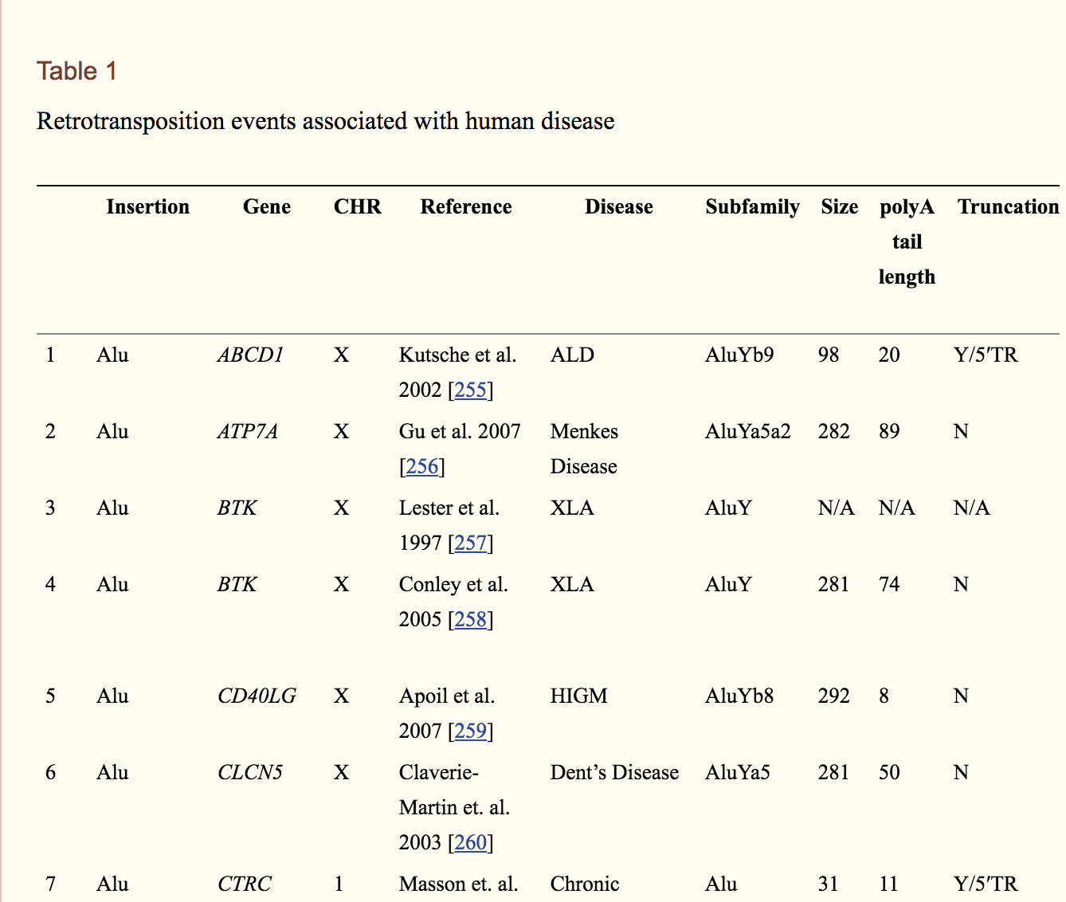
How do TEs affect the genome functionally?
In Humans the LINE1 family (1 germline insertion in 95 births) and the ALU,SVA (1 germline insertion in 21 births) families which are Class1 TEs are still active
Are they Dangerous? Possibly :
They can disrupt gene function near an insertion and are documented to cause 124 different diseases¹
However, a lot of TE’s have been “domesticated” as well, and serve cis-regulatory roles. Half of open chromatin regions in mammals lie in TE derived sequences
1.)Hancks, D. C. & Kazazian, H. H. Roles for retrotransposon insertions in human disease. Mob. DNA 7, 9 (2016)

Slide 5
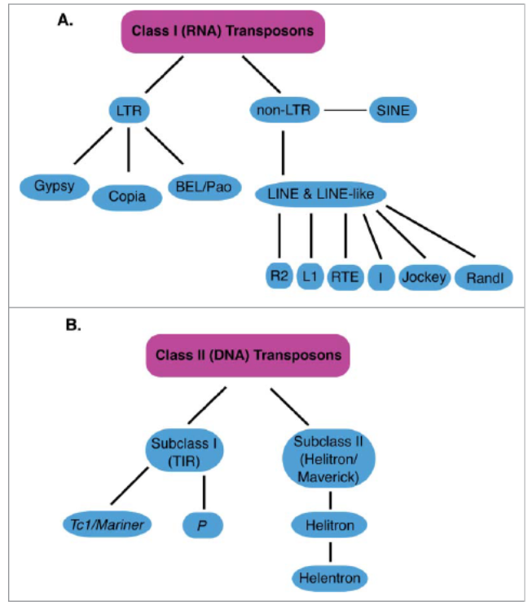
TE families and classification:
Retrotransposons (RNA transposons)Class 1:
“Copy and paste” mechanism of transposition
LTR and non LTR familes(LINE,SINE)are the major subfamilies
LINE and SINE Account for 35% of the human genome.
DNA Transposons:
“Cut and Paste” mechanism of transposition
Only 3% of Human genome, they are not active in humans
Mccullers, Tabitha & Steiniger, Mindy. (2017). Transposable elements in Drosophila. Mobile Genetic Elements. 7. 00-00. 10.1080/2159256X.2017.1318201.

Slide 6
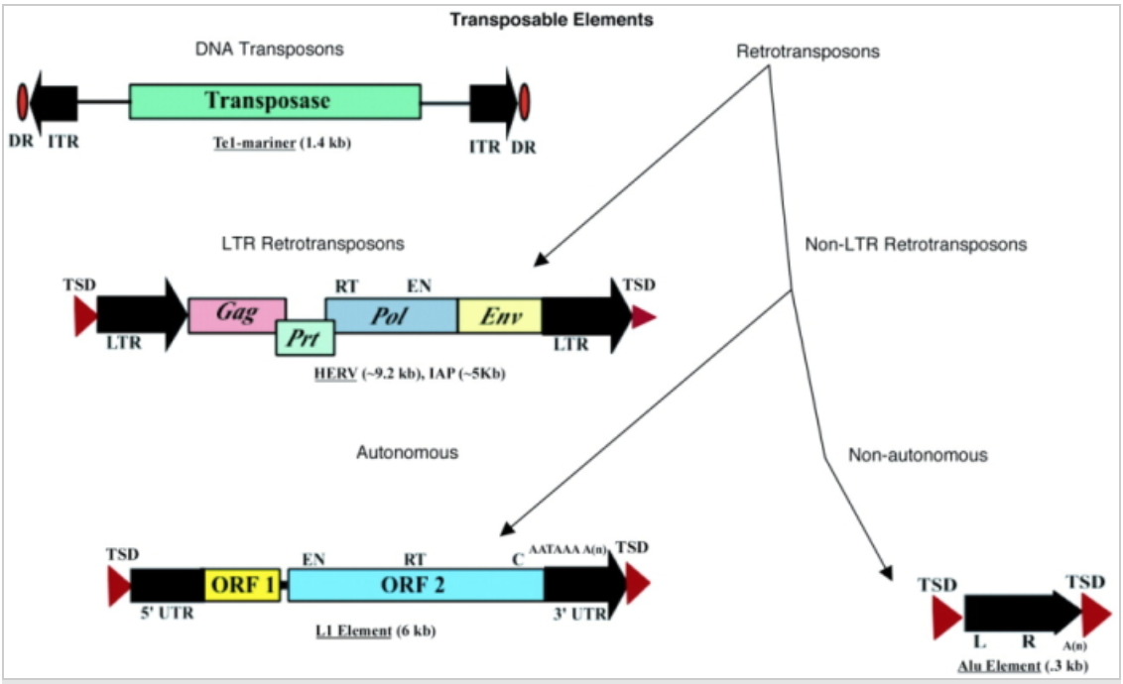
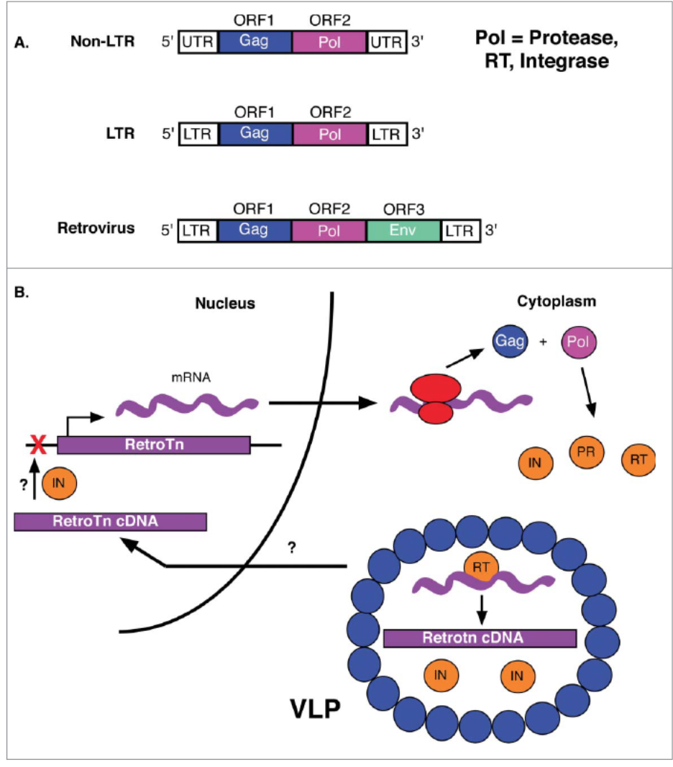
The structure of TEs
https://www.nature.com/scitable/topicpage/transposons-the-jumping-genes-518
https://www.nature.com/scitable/topicpage/transposons-the-jumping-genes-518

Slide 7
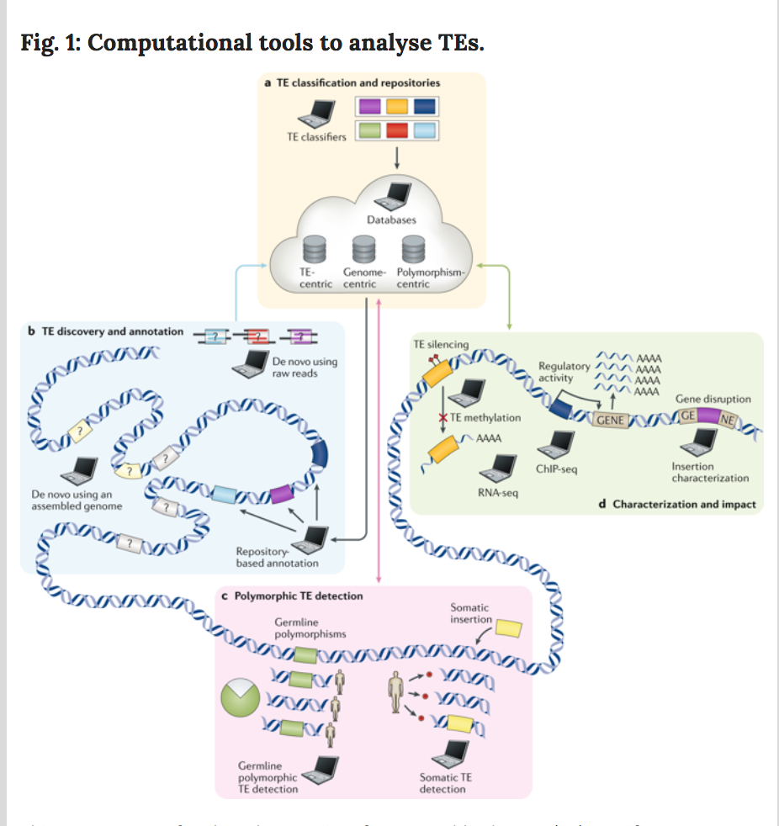
Computational tools to analyze TEs
a. TE phylogeny can be established using TE classification software
b. TE discovery and annotation tools label TEs in assembled genomes either through sequence homology from TEs found in databases or de novo methods
c. Polymorphic TE detection tools identify novel insertions that are absent from the reference genome
d. TE characterization tools either provide information on novel TE insertions or assess the functional impact of genomic TEs through RNA sequencing (RNA-seq), ChIP-seq, methylation or DNA sequencing analysis.
Goerner-Potvin, Patricia, and Guillaume Bourque. "Computational tools to unmask transposable elements." Nature Reviews Genetics (2018): 1.

Slide 8
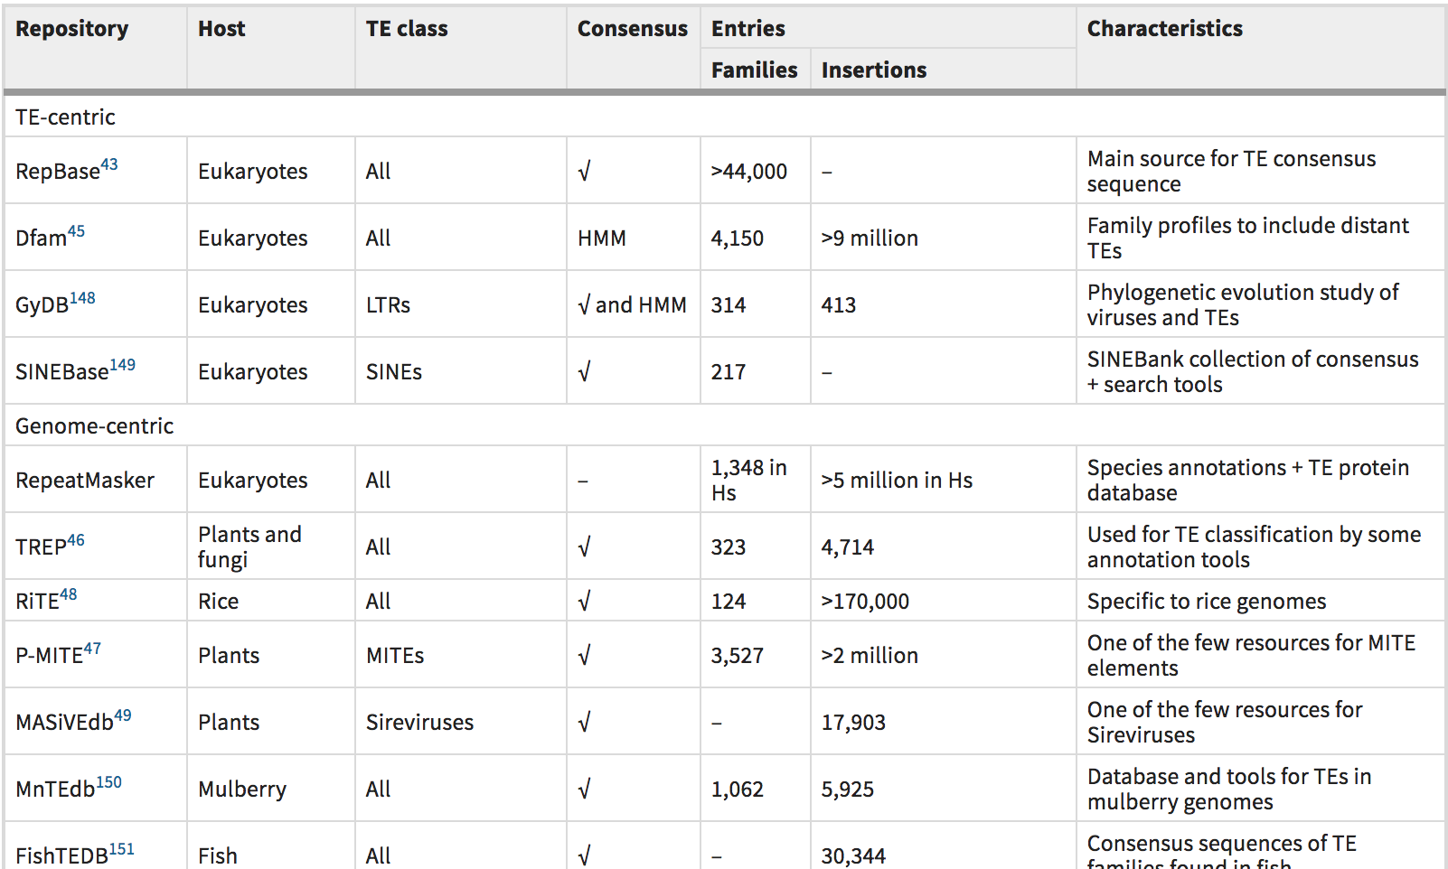
TE repositories
1.TE Centric Repos
2. Genome Centric Repos
3.Polymorphism Centric
Notes:
First step to identify TEs: look up the different reopsitories available. TE family centric repos:
And Genome centric based repos available.
RepeatMasker uses the RepBase and Dfam TEs and helps to annotate the genome in Eukaryotes
There are also Polymorphism Centric repos for L1, but lacking for ALUs in humans

Slide 9
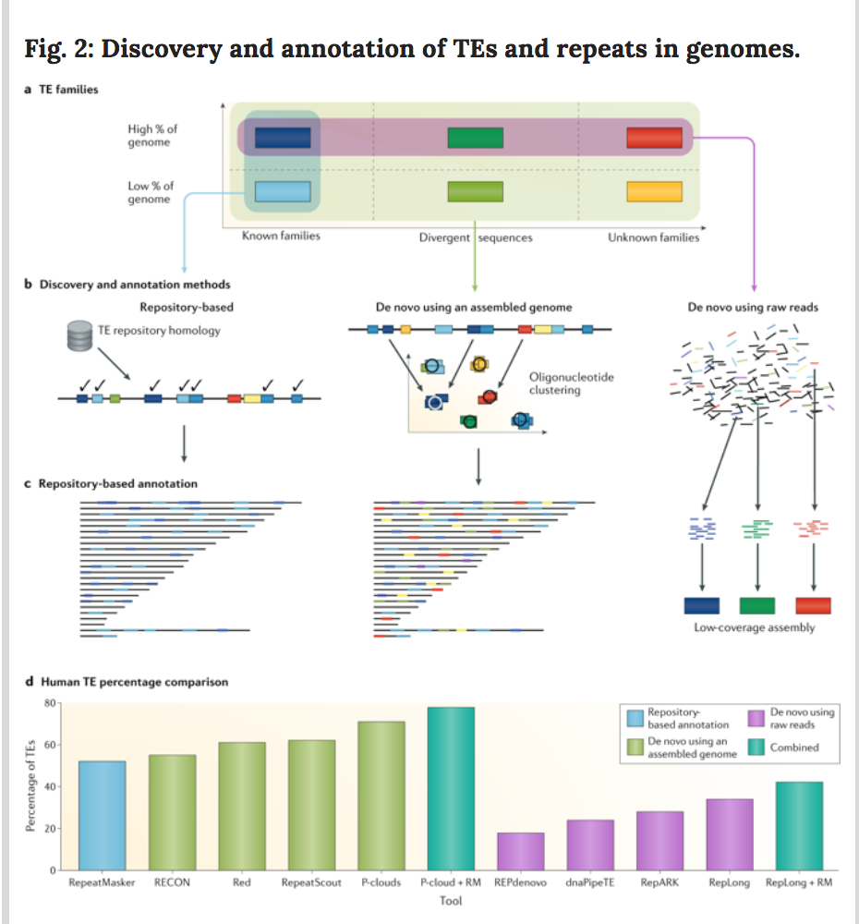
Discovery and annotation of TEs within a genome
Can annotate using known TE repository annotations or can also annotate De- Novo
De Novo annotations can discover new TE families not in the databases, but can have a higher false positive rate
De Novo discovery methods Come in two kinds
1.)Need Assembled Genome
2.)Discover TEs from raw sequencing reads (no assembly needed)

Slide 10
Red(repeat discovery): an intelligent, rapid, accurate tool for detecting repeats de-novo on the genomic scale
Model Inputs: Sequences in FASTA format
Step 1: Score k-mers based on their occurance frequency in the genome wrt. a markov chain trained on the same genome
Labeling steps
Step 2: Score each nucleotide in a sequence based on the k-mer starting there
Step3 : Smooth the scores with a Gaussian Kernel, and do peak detection , label
Train step:
Step 4: Train an HMM to smooth this (Repeats and Non repeats are the hidden states) Intuitively, lots of high scores interspersed with some low scores indicates a repeat, and lots of low scores interspersed with high scores in a non repeat
Annotate:
Step 5: Use the trained HMM to annotate the Genome (with the smoothed k-mer weights encoding); and Viterbi decoding of the hidden states
Red: an intelligent, rapid, accurate tool for detecting repeats de-novo on the genomic scale. BMC Bioinformatics. 2015;16:227. Published 2015 Jul 24. doi:10.1186/s12859-015-0654-5

Slide 11
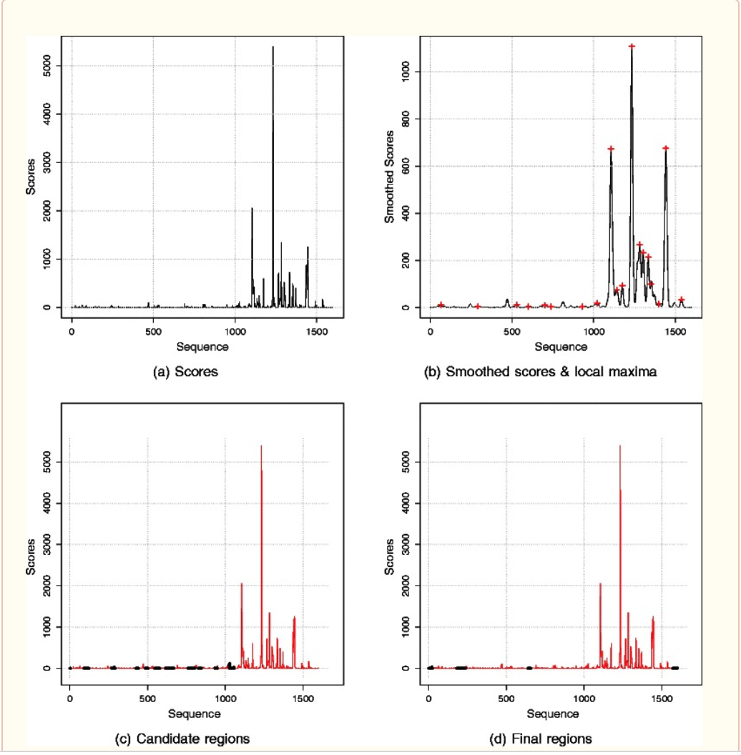
Red(repeat discovery): an intelligent, rapid, accurate tool for detecting repeats de-novo on the genomic scale

Slide 12
DNA annotation from Raw Reads RepeatExplorer algorithm
This is needed when we do not have an assembled genome, but we do have sequencing done that maybe be low depth (not high enough for assembly)
They are different Graph based clustering algorithms
Graph is constructed with the Vertices being reads and edges (weights) being pairwise sequence similarity (which is thresholded at some minimum)
Community detection is then done on the Graph with a hierarchical agglomeration algorithm
A similar algorithm called RepLong works with long reads and graph clustering and has higher recall. This assigns repeats to 35% of the Human genome
In general, De Novo annotation from raw reads assigns lesser numbers of repeats than De Novo methods that require an assembled genome
Novák P, Neumann P, Macas J. Graph-based clustering and characterization of repetitive sequences in next-generation sequencing data. BMC Bioinformatics. 2010;11:378. Published 2010 Jul 15. doi:10.1186/1471-2105-11-378

Slide 13
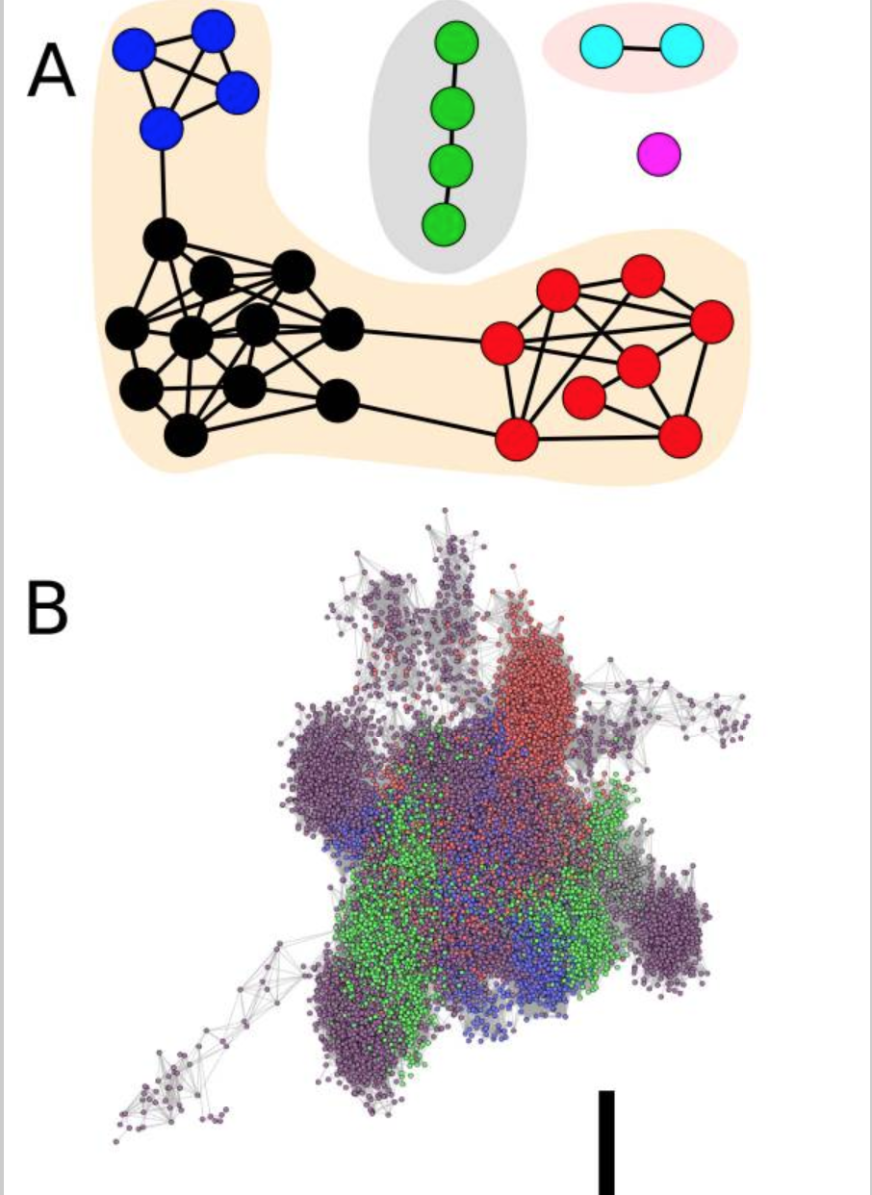
DNA annotation from Raw Reads RepeatExplorer algorithm
Identify communities
Identify connected components in the graph

Slide 14
Shortcomings of DeNovo Annotation
Comparing the fraction of the genome assigned to repeats by different methods
Different De-Novo methods assign a differnt fraction of the genome to repeats
Methods based on assembled genomes assign a higher fraction, but are more prone to false positives
Methods based on raw reads give more conservative numbers
Some systematic benchmarking of the different tools is needed

Slide 15
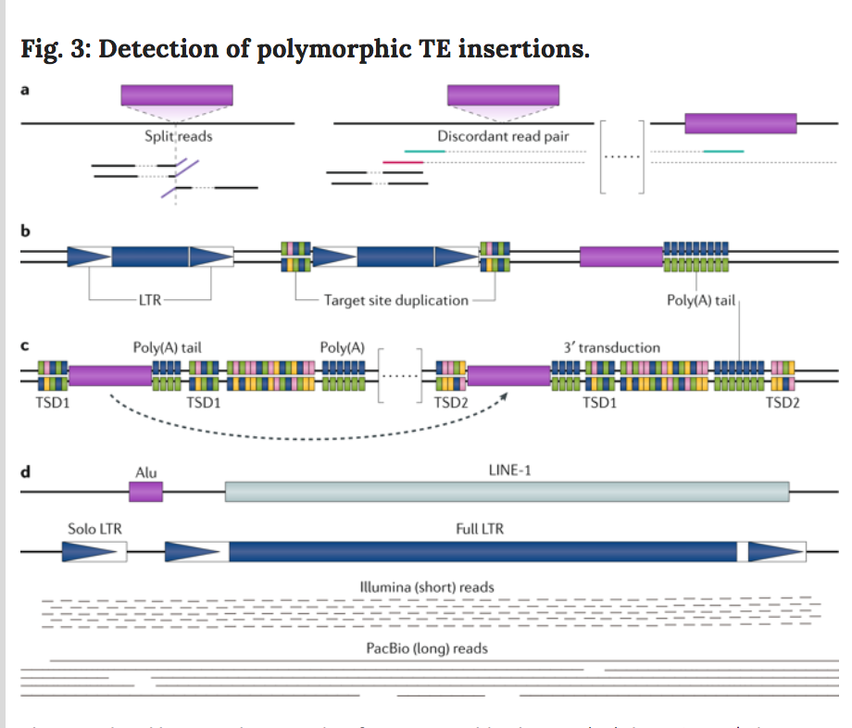
Tools to detect TE polymorphisms
Lets say we have an annotated reference genome and all its mobile (TE) elements
How do we detect new polymorphisms (insertions of TEs) in a new individual whom we sequence?
Similar to SNPs, polymorphic insertions lead to different phenotypes such as Rett’s syndrome, Haemophilia
When we have short reads, we can look for SR or DRP
SR: Split Reads,part of the read maps to ref genome, rest maps to a distant TE
DRP: Discordant read Pair: If we have paired end sequencing and different ends map to very distant genomic locations
We can also use known TE motifs like known LTRs or Poly A tails to identify insertions of TEs
With PacBio long reads, it is much simpler as a read can span an entire TE (ex. LoRTE)
Generally tools such as NGS TE mapper use a combination of SR, DRP and TE motifs to identify polymorphic regions

Slide 16
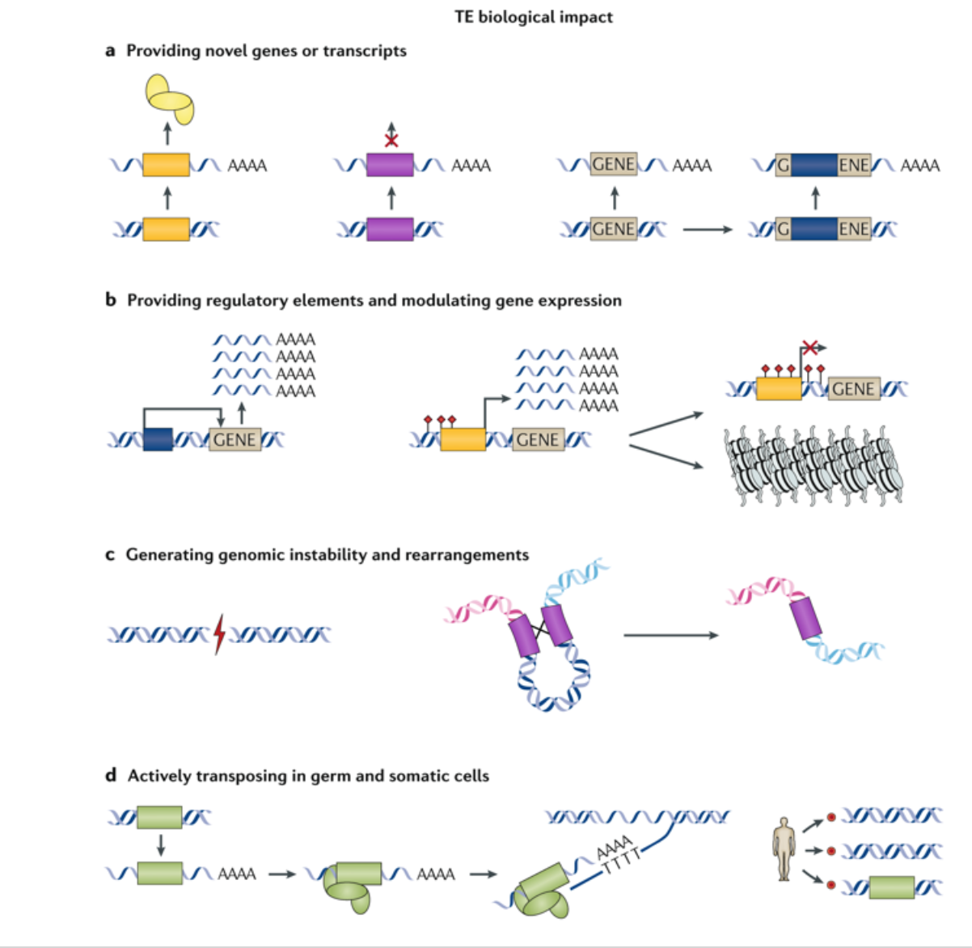
Regulatory impact of TEs

